Slide 1
Medieval Europe
A general overview –
PERSIA TLC

Slide 2
POLITICAL Aspects of Medieval Europe:
-Monarchy:
Landed aristocrats – gained land and power
Some became “kings”
Ex. Frankish Kingdom, Kingdom of England
-Feudalism:
Response to Viking invasions
Local lords – offer land & protection
Vassals – provide service (military & agricultural)

Slide 3
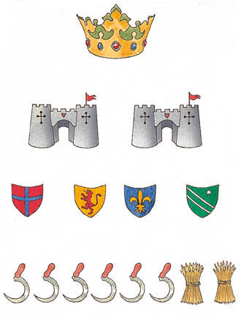
POLITICAL Aspects of Medieval Europe:
-Structure of a Kingdom

Slide 4
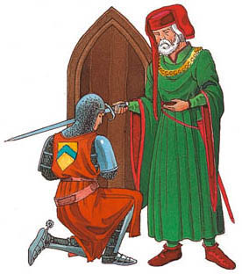
POLITICAL Aspects of Medieval Europe:
-Oath of Fealty from Vassal (Knight) to the Lord (Baron, Duke, etc.)

Slide 5
ECONOMIC Aspects of Medieval Europe:
-The Barter System:
Exchanging of goods/services for other goods/services
-Banking:
Coins to purchase goods
Exchange currencies
-Varied Trades & Professions
-The Manorial System
-Trade Routes:
Extended throughout Europe, Northern Africa, the Middle East, & extends into Asia
-Agricultural Production
-THE BUBONIC PLAGUE!!!

Slide 6
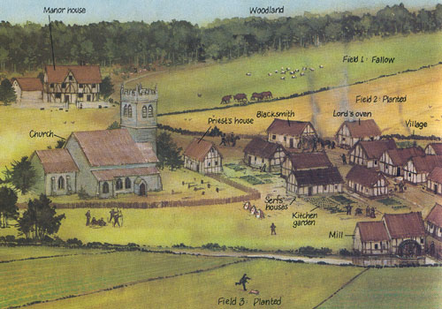

Slide 7
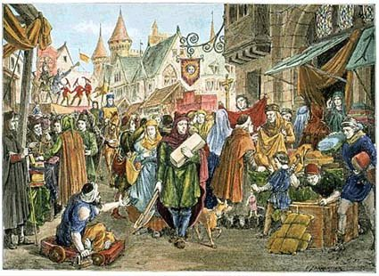
ECONOMIC Aspects of Medieval Europe:
Medieval European Market - Bartering

Slide 8
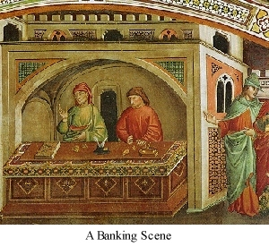
ECONOMIC Aspects of Medieval Europe:
-Banking

Slide 9
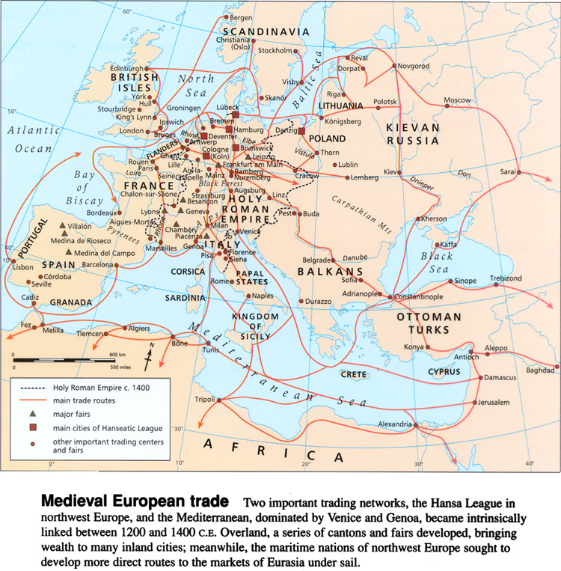

Slide 10
RELIGIOUS Aspects of Medieval Europe:
-The Catholic Church:
Organized church by end of 2nd c. CE
Hierarchy of the Church
Preserved “classical” civilization
Monks (Monasteries) & Nuns (Convents)
-The Schism:
1054 CE – split of Christian Church into two branches
-Western (Latin) Europe – Roman Catholic
-Eastern (Greek) Europe – Eastern Orthodox
-The Crusades:
-Mostly religious wars b/w Christians & Muslims
-4th Crusade – Western Europe vs. Byzantine Empire
-THE BUBONIC PLAGUE!!!

Slide 11
RELIGIOUS Aspects of Medieval Europe:
-Roman Catholic Church Hierarchy

Slide 12
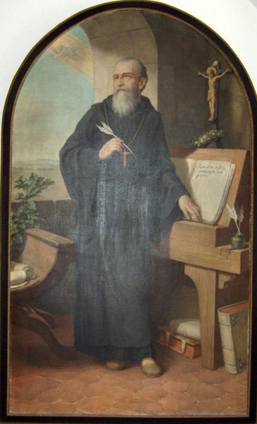
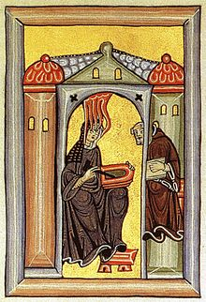
RELIGIOUS Aspects of Medieval Europe:
-St. Benedict, founder of Benedictine Monks
-Hildegard of Bingen

Slide 13
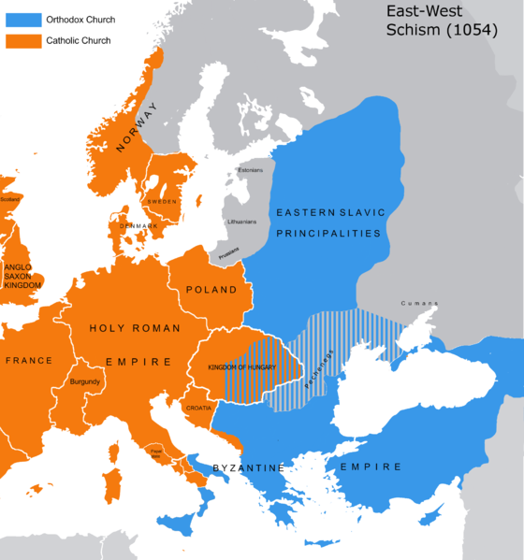

Slide 14
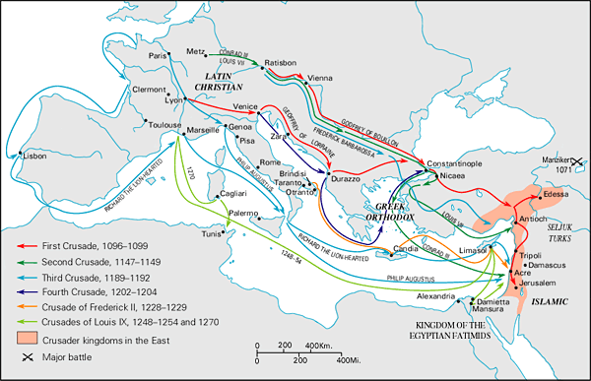

Slide 15
SOCIAL STRUCTURE Aspects of Medieval Europe:
-Feudalism
Protection & land in exchange for services
-Manorial System
Restricted trades/jobs of individuals
Serfs (not slaves, but close)
-The Catholic Church
Imposed restrictions on everyday life

Slide 16
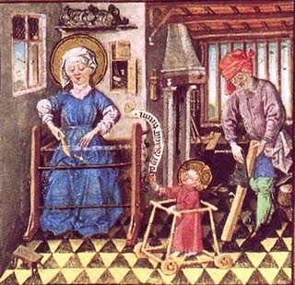
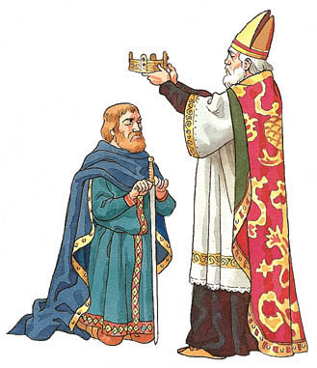

Slide 17
INTELLECTUAL/TECHNOLOGICAL Aspects of Medieval Europe:
-Magna Carta
Limitation of government powers
-Gutenberg’s Printing Press (1500s)
Moveable type
More books – cheaper – more affordable
-University System
Oxford – 1st public univ. in Europe
-Carruca
Wheeled plow
-Three-field system of farming
Greater production & variety of crops

Slide 18
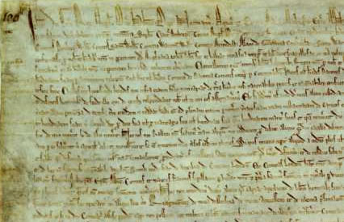
INTELLECTUAL & TECHNOLOGICAL Aspects of Medieval Europe:
-Magna Carta – English document of obligations between lord & vassals

Slide 19
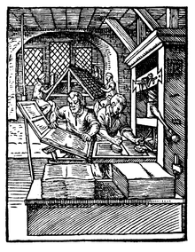
INTELLECTUAL & TECHNOLOGICAL Aspects of Medieval Europe:
-Johannes Gutenberg’s Movable Type Printing Press

Slide 20
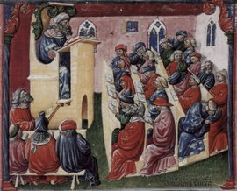
INTELLECTUAL & TECHNOLOGICAL Aspects of Medieval Europe:
University Lessons

Slide 21
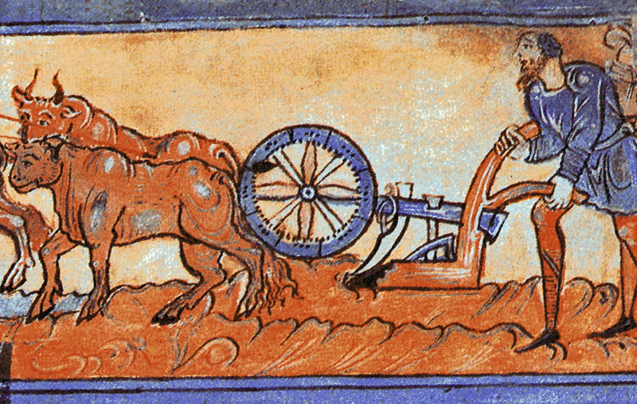
INTELLECTUAL & TECHNOLOGICAL Aspects of Medieval Europe:
Heavy-Wheeled Plow, or Carruca

Slide 22
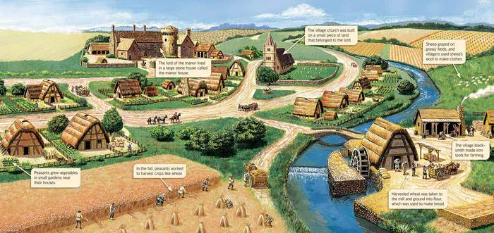

Slide 23
ARTISTIC Aspects of Medieval Europe:
-Gothic Architecture
Notre Dame Cathedral, Paris
-Illuminated Manuscripts
Monks illustrating the Bible
The Book of the Kells
-The Bayeux Tapestry
Story of Battle of Hastings (1066)
-Stained Glass
Story-telling for illiterate
-Manor Houses
Changes in architecture (1st priority – safety)

Slide 24
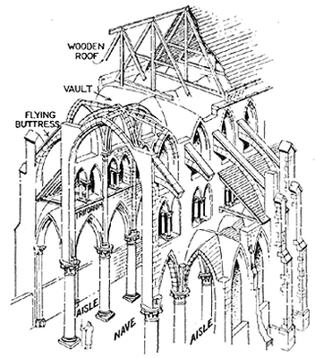

Slide 25
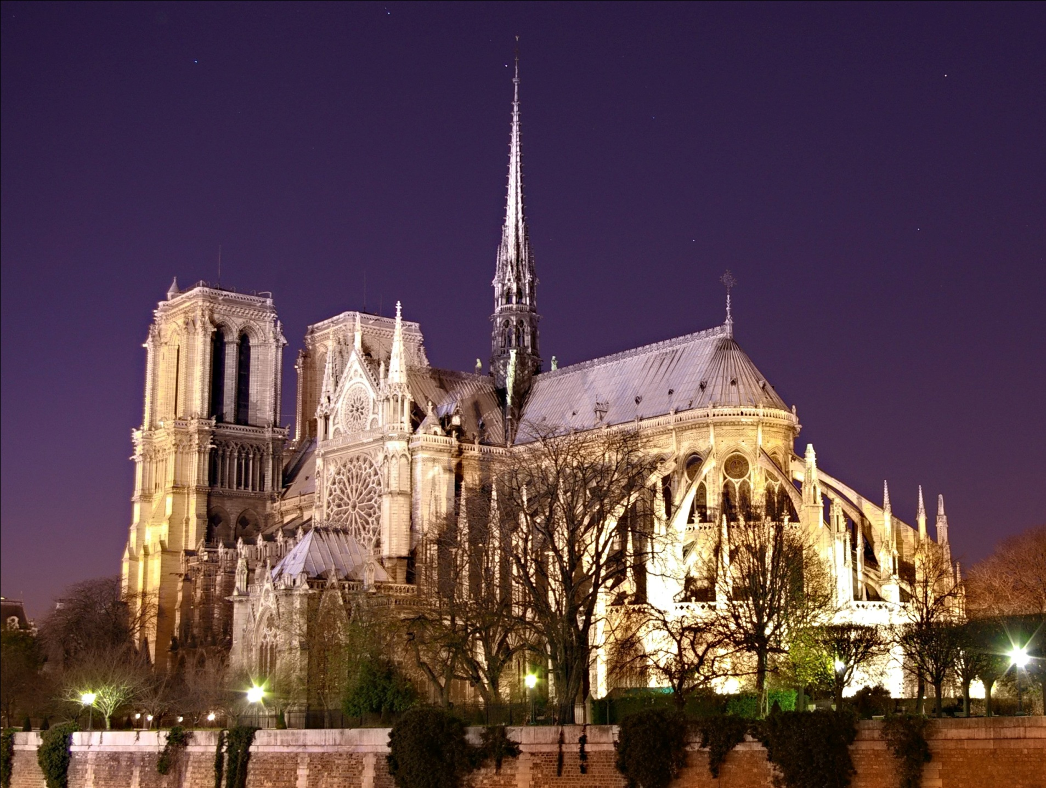

Slide 26
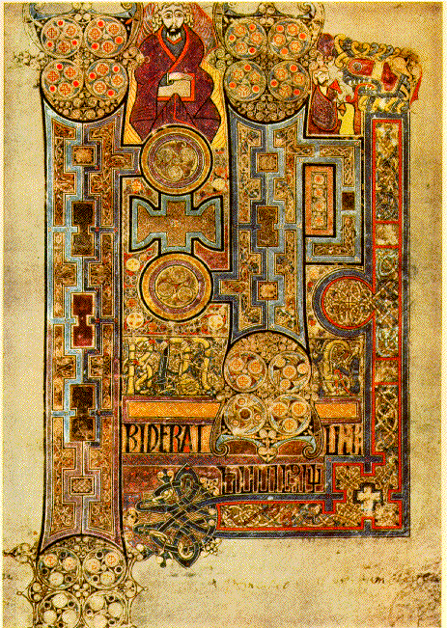
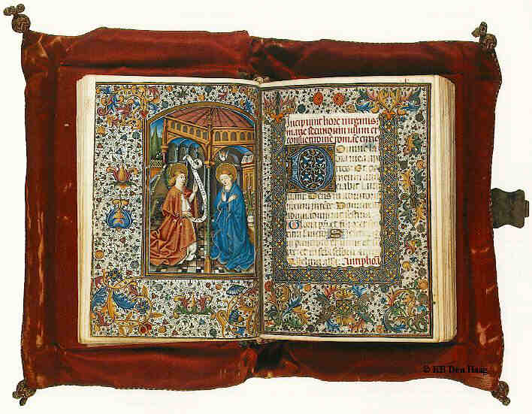
ARTISTIC Aspects of Medieval Europe:
-Illuminated Manuscripts

Slide 27
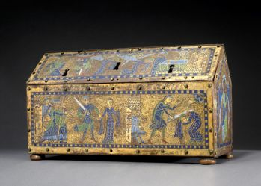
ARTISTIC Aspects of Medieval Europe:
-Religious Relic Box – Contained bones, ashes, clothing, etc. believed to belong to important figures within Christian history

Slide 28
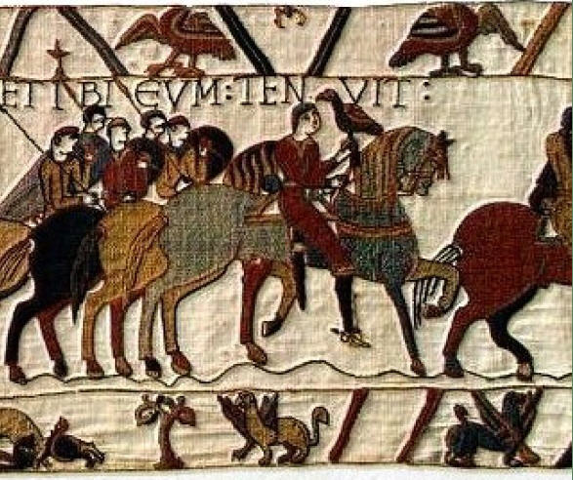

Slide 29
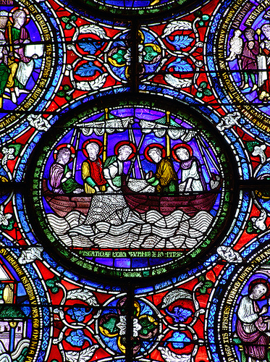

Slide 30
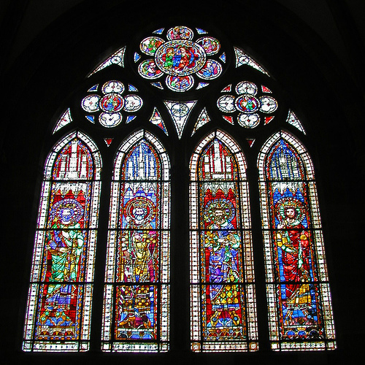

Slide 31
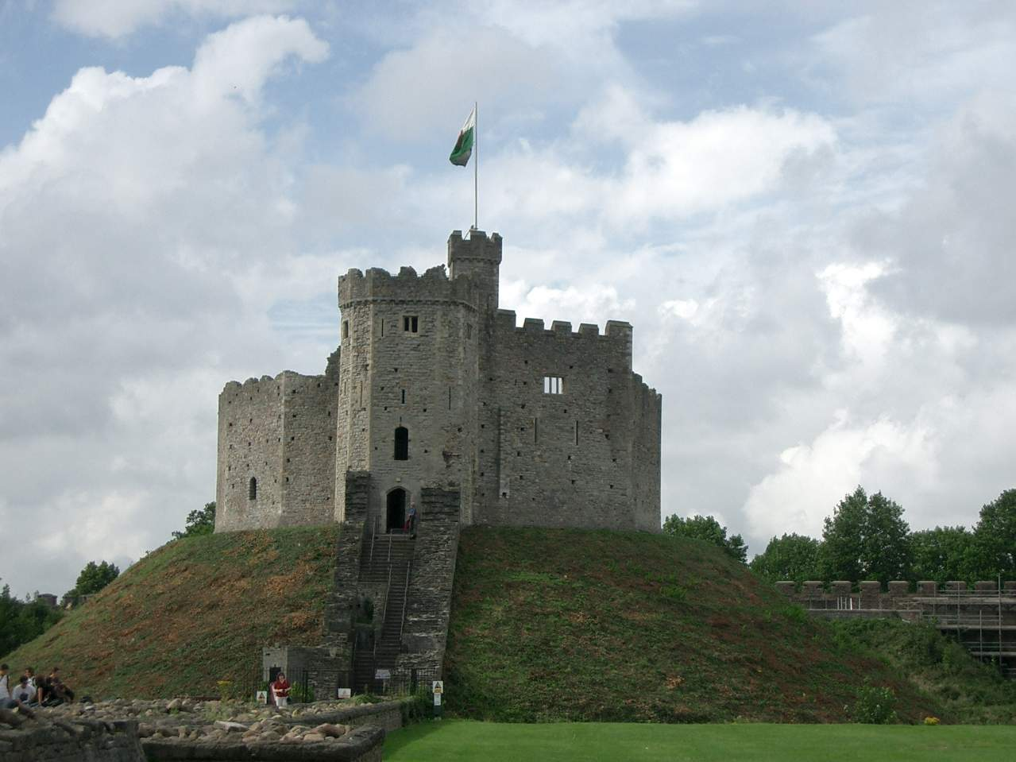

Slide 32
LEADERSHIP Aspects of Medieval Europe:
-Charlemagne
Carolingian Empire & Renaissance of Learning
-Pope Urban II
Called for a Crusade against infidels in the Holy Land
-Joan of Arc
Heroine for the French People in the Hundred Years’ War
-King John
Signed Magna Carta
-Saladin, King Richard the Lionheart, Philip Augustus, & Frederick Barbarossa - Involved in the 3rd Crusade

Slide 33
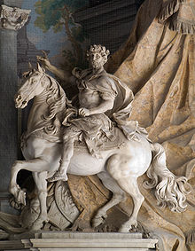
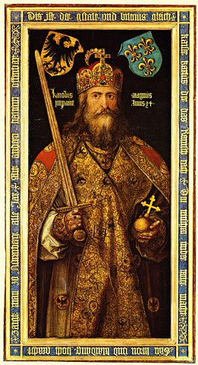
LEADERSHIP Aspects of Medieval Europe:
-Charlemagne

Slide 34
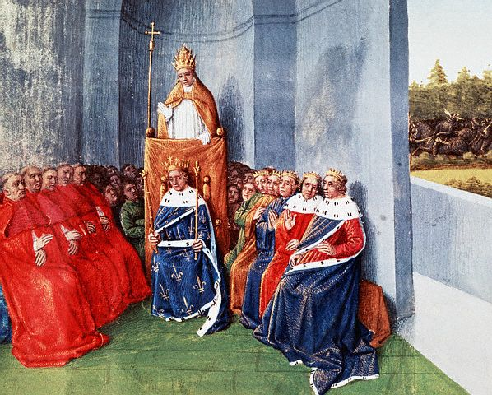
LEADERSHIP Aspects of Medieval Europe:
-Pope Urban II – 1st Crusade

Slide 35
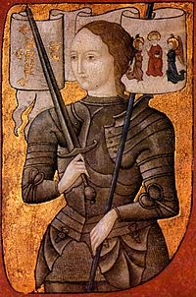
LEADERSHIP Aspects of Medieval Europe:
-Joan of Arc (1485)

Slide 36
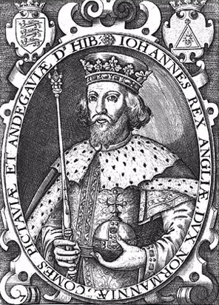
LEADERSHIP Aspects of Medieval Europe:
-King John (1166-1216)

Slide 37
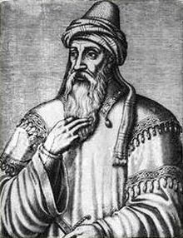
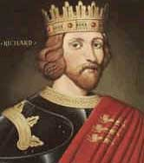
LEADERSHIP Aspects of Medieval Europe:
-Saladin
LEADERSHIP Aspects of Medieval Europe:
-King Richard the Lionheart

Slide 38
CONFLICT Aspects of Medieval Europe:
-The Viking Invasions
Led to feudalism
-THE BUBONIC PLAGUE!!!
Between 50-60% of Europe’s population died in 4 years
-The Crusades
Especially First through Fourth
-The Hundred Years’ War
Shift in power between England & France
-Church vs. Secular Rulers
Struggles between the power of the Popes and the power of the Kings

Slide 39
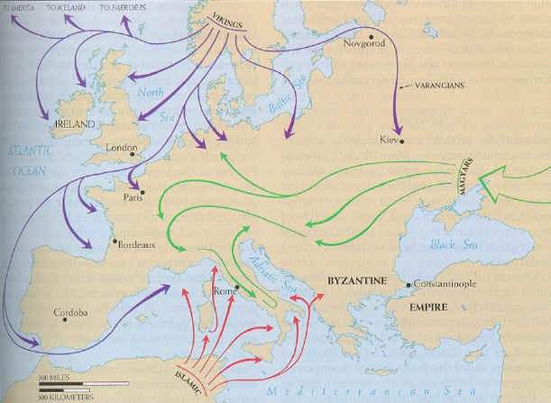

Slide 40
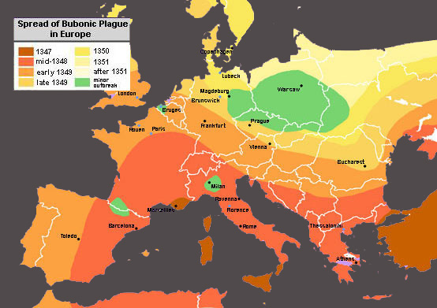

Slide 41
